Slide 1

TripAdvisor
My Local Best Friend Feature

Slide 2
TripAdvisor: My Local Best Friend Feature
Monetization Model:
Paid ads from restaurants and attractions
Subscriptions from users for frequent travellers
One time payment for travelers to one country
Deep links to services (ride hailing, nail salons, restaurant bookings)

Slide 3
TripAdvisor: My Local Best Friend Feature
I travelled a lot in the past year. And everywhere I go, I have always felt that the experience is not personal enough. It could be improved if I just had that one best friend who happened to be local and recommended the hidden/authentic places he enjoyed himself. I also would have a much smoother time if there is an app that could flag all the potential risks along the journey into a new country (such as long waiting time at immigration, forbidden Uber nearby airports, early sold out tickets at popular attractions...) and the mitigation/best alternatives.
The current TripAdvisor app does not feel personalized enough (beyond the standard attractions and tour offers) and does not feature the most oldie but goodie restaurants frequented by locals

Slide 4
TripAdvisor: My Local Best Friend Feature
User Understanding - Demographic
Young professionals aged from 18 to 40 years old (born in the 80s and beyond)
This group lives all over the world and has spare income to travel for experiences (less for business)
People who are active on Social Media and follow influencers (fitness, travel mom, beauty, showbiz, etc)

Slide 5
TripAdvisor: My Local Best Friend Feature
User Understanding - What are they like in person? (Persona)
Greg is a 31 year-old traveller who is new to Ho Chi Minh City
He uses mobile app for everyday activities at home (Uber, Doordash, Yelp)
He works in Boston in tech & travels to Vietnam with his girlfriend this spring
He loves travelling to exotic destinations and explores local life but is afraid of language barriers and foreigner rip off
Because VN is so exotic, he has no friends here to ask for advice of the best places to do X (just like Morocco, Sri Lanka, Czech - where he’s been to)
His gf and Greg love working out and try to get daily exercise everywhere they go. They want to know which gyms in HCMC offer daily pass, speak English and offer the best classes in town

Slide 6
TripAdvisor: My Local Best Friend Feature
User Understanding - What are their pain points?
Has no knowledge of local administrative variations that could cost them money, pain and time
Travel recommendations are not personalized based on their tastes, preferences and profile, which could result in a generic, uneventful trip

Slide 7
TripAdvisor: My Local Best Friend Feature
Product Goal:
enable safe, memorable, hassle free travel experiences
bridge the gap between travelers’ expectation and experience

Slide 8
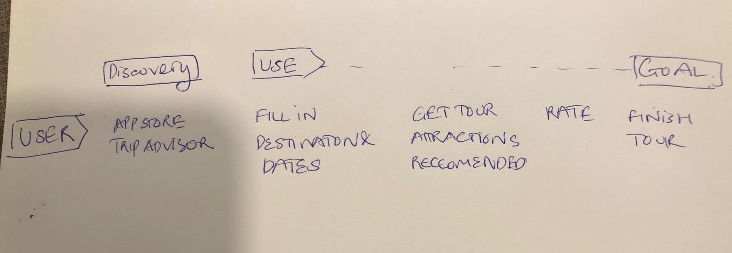
TripAdvisor: My Local Best Friend Feature
Map the challenge

Slide 9
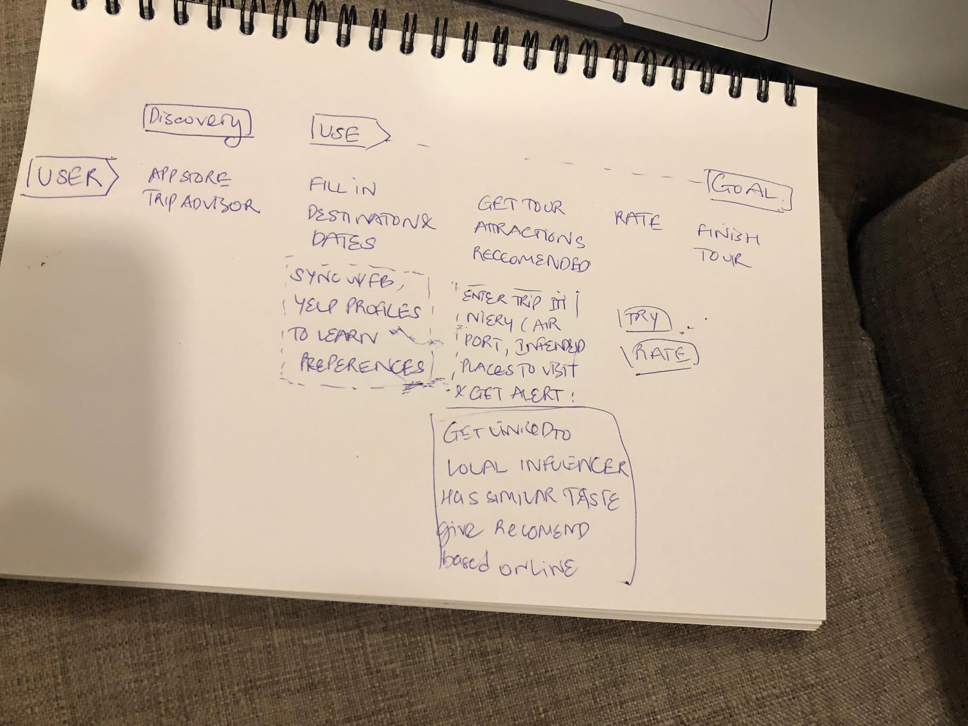
TripAdvisor: My Local Best Friend Feature
How Might We

Slide 10
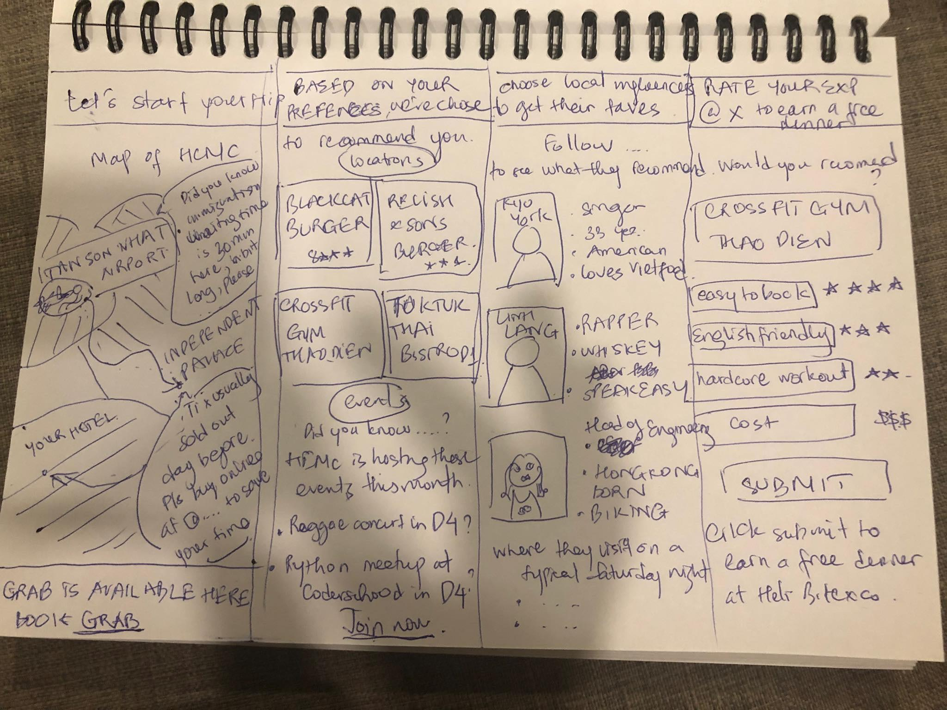
TripAdvisor: My Local Best Friend Feature (5-8)

Slide 11
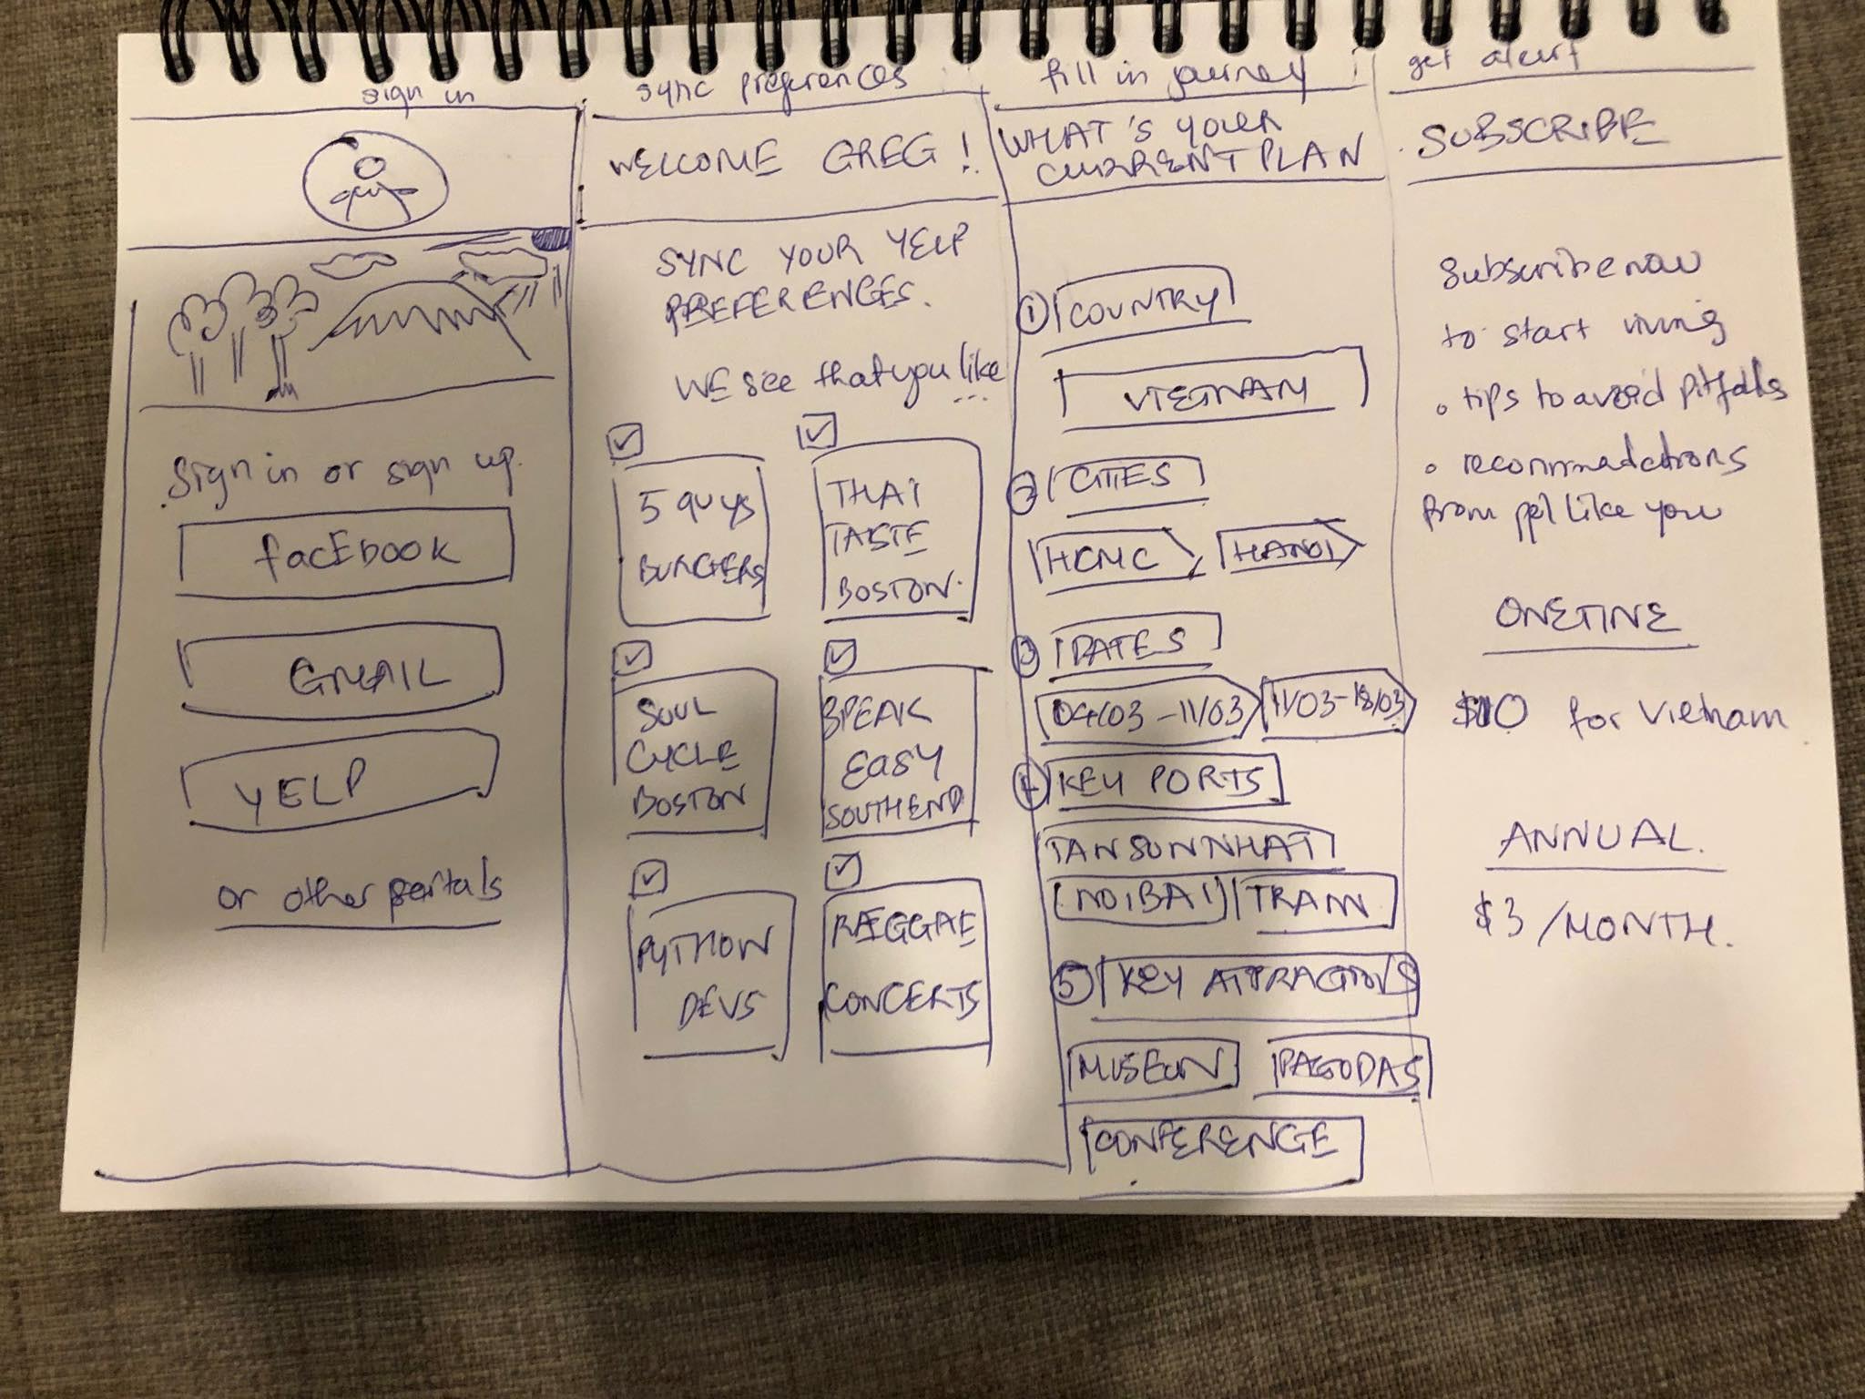
TripAdvisor: My Local Best Friend Feature (1-4)

